Slide 1
Supervisor MEETING 2
G4-T6: JASON (PM), JEREMY, SHU WEI, WU WEI & YONG SIANG
SUPERVISOR: PROF. LEE YEOW LEONG
DATE: 16th OCT 2015, FRIDAY

Slide 2
agenda
Progress for the past two weeks.
Who did what?
Any deviation from the planned schedule?
Goal(s) for the coming two weeks and immediate milestone.
Any problems (existing or potential) that threaten the successful, on-time completion of your project.
What is the current status of all three metrics?

Slide 3
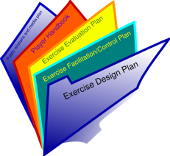
Progress for the past two weeks
Iteration 2
(29 Sep – 10 Oct 15)
Class diagrams & Sequence diagrams
Test Cases & Mitigation plans
Peer sharing session of codes
Project Administration
Coding
Top-K Usage Report (All functions completed)
Smartphone Overuse Report (All functions completed)
Basic App Usage Report (All functions completed)
Bootstrap (Validation for demographics, app & applookup.csv, creation and loading to SQL table)
Integration & Deployment
Integrating & testing with earlier functionalities
Deploy application to OpenShift. Testing & debugging on Openshift (if any test case failed)

Slide 4
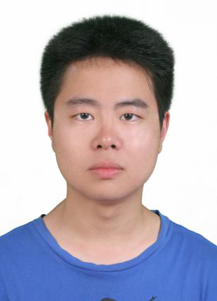

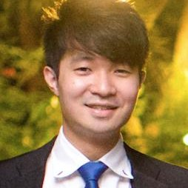

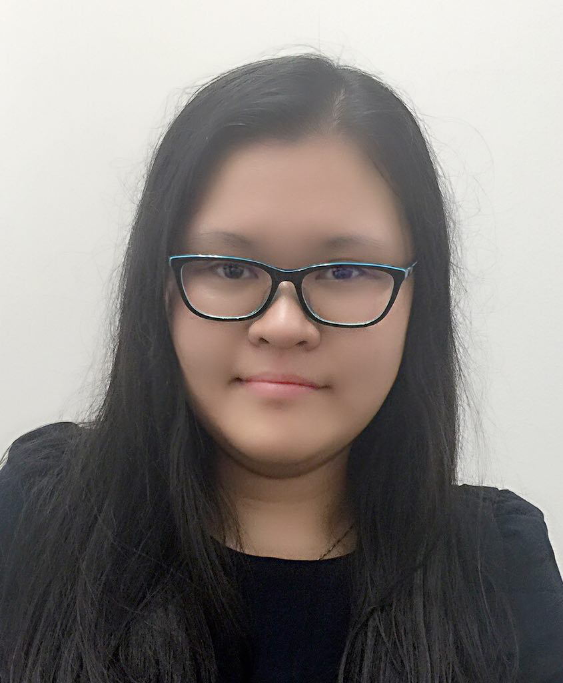
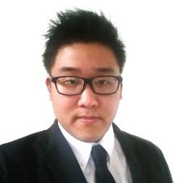
Who did what?
WU WEI (PM for Iteration 2)
Class Diagrams & Sequence Diagrams
Test Cases, Mitigation Plans & Bug Metrics
Integration & Deployment
JASON & YONG SIANG
All functionalities of Basic App Usage Report
SHU WEI & WU WEI
Bootstrap (Validation for demographics, app & applookup.csv)
Bootstrap (Creation & loading to SQL Table)
SHU WEI & JEREMY
All functionalities of Top-K Usage Report
All functionalities of Smartphone Overuse Report
Notes:
Make sure you have your latest build on the deployment server and ready to demo. Source code checked out to your laptop and be ready to explain your codes.

Slide 5
deviation from the planned schedule?
Iteration Schedule Metrics
Description | Basic App Usage Report: Breakdown By Usage time category & Demographics
Duration Delayed | 1 day
Reason | One of the pair-programmers (Yong Siang) was not able to make it due to last minute involvement in AceTech 2015
Result | Functionality is delayed for 1 day
Mitigation Plan | Reschedule the pair-programmers session on 6 Oct 15 at 13:30 hrs

Slide 6
deviation from the planned schedule?
Iteration Schedule Metrics
Description | Basic App Usage Report: Breakdown By Usage Time Category & Demographics
Duration Delayed | 6 days
Reason | Underestimated the complexity and time required of the functionality Misunderstood the concepts of the functionality
Result | Functionality is partially completed but will be delayed for 6 days
Mitigation Plan | Smartphone Overuse Report is reassigned to another pair-programmers (SHUWEI & JEREMY). The pair-programmers (JASON & YONG SIANG) continue with Basic App Usage Report: Breakdown By Usage Time Category & Demographics. Continue other functionalities as scheduled. A buffer day (12 Oct) is used to work on it *Functionality is completed on 12 Oct* Testing have not been conducted and will be done on the coming scheduled testing session on 24 Oct.

Slide 7
deviation from the planned schedule?
Iteration Schedule Metrics
Description | Top-K App Usage Report
Duration Delayed | 1.48 hrs
Reason | Underestimated the complexity and time required of the functionality
Result | Functionality has successfully completed
Mitigation Plan | Pair-programmers coded over-time to complete the functionality

Slide 8
deviation from the planned schedule?
Iteration Schedule Metrics
Description | Top-K App Usage Report: Top-K students with most app usage (Given an app category)
Duration Delayed | 1.00 hrs
Reason | Underestimated the time for debugging during the development phase
Result | Functionality has successfully completed
Mitigation Plan | Pair-programmers coded over-time to complete the functionality

Slide 9
Goal(s) for the coming two weeks and immediate milestone.
Develop Functionalities
Dual Interfaces (Implementation of JSON API)
Basic App Usage Report
Top-K App Usage Report
Smartphone Overuse Report
Login
Bootstrap
Develop Functionalities
Validation of location.csv
Develop Deletion of data
Develop Location Data
Upload location.csv file to database
Upload addition location data to database
Develop Web UI for deletion of data

Slide 10
Goal(s) for the coming two weeks and immediate milestone.
Project Administration
Update relevant documentations
Class & Sequence Diagrams
Test Cases & Metrics
Integration & Deployment
Testing & Debugging
Milestones
UAT on Week 12
Next Milestone
Supervisor Meeting 3 on 30 Oct 15
Immediate Milestone

Slide 11
Any problems?
Existing:
Inaccurate estimation of time for implementing Dual Interfaces (JSON APIs) due to its complexity.
JSON output maybe incorrect and more time is required to debug these issues
Potential (Foreseeable):
Smartphone Usage Heatmap & Social Activeness Report functionalities could be relatively complicated than as expected
Certain test cases for certain functionalities could be missed out
Outputs from previous functionalities might be incorrect. Thus, additional time may required to debug these issues
Might have insufficient time to beautify UIs (Twitter Bootstrap)
Notes:
Any problems (existing or potential) that threaten the successful, on-time completion of your project.

Slide 12
Project METRICS
Tasks
No. of Iterations
SM

Slide 13
Project METRICS (Detailed)
Project Iteration Metrics
Iteration | No. of Assigned Tasks (Planned) | No. of Completed Tasks (Actual) | Task Metric | Estimated Days | Actual Days | Schedule Metric | Action
1 | 17 | 17 | 100% | 11 | 11 | 100% | No action required
2 | 27 | 27 | 100% | 11 | 12 | 91.67% | Re-estimate the duration of the tasks for future iterations.

Slide 14
Bug metrics
Impact Scores
TOTAL SCORE
= 1 x 2 (Low) + 1 x 5 (High) + 1 x 0 (Critical)
= 7
Notes:
Show evidence of tracking. Note: the pplog software only computes the metric numbers for your schedule metrics. You still need to show us evidence of tracking and using (i.e., you looked at the number and did the right mitigation) the metric values. You also need to show us your tracking, and actions taken for your bug metric

Slide 15
Bug metrics (Detailed)
ITERATION | S/N | FUNCTION | DESCRIPTION OF BUG | CAUSE
2 | 1 | Login | Wrong username and password results in page crash | IndexOutOfBoundException
CORRECTION MADE | SEVERITY | DATE FOUND | FOUND BY | DATE SOLVED | SOLVED BY | CURRENT SCORE
Made changes to UserDAO | Low | 10-10-2015 | SHUWEI & WUWEI | 10-10-2015 | SHUWEI | 1
ITERATION | S/N | FUNCTION | DESCRIPTION OF BUG | CAUSE
2 | 2 | Bootstrap on Demographics validation | Gender is not case insensitive | The validation includes case sensitivity
CORRECTION MADE | SEVERITY | DATE FOUND | FOUND BY | DATE SOLVED | SOLVED BY | CURRENT SCORE
Made changes to UserValidation | Low | 10-10-2015 | SHUWEI & WUWEI | 10-10-2015 | SHUWEI | 1
Notes:
Show evidence of tracking. Note: the pplog software only computes the metric numbers for your schedule metrics. You still need to show us evidence of tracking and using (i.e., you looked at the number and did the right mitigation) the metric values. You also need to show us your tracking, and actions taken for your bug metric

Slide 16
Bug metrics (Detailed)
ITERATION | S/N | FUNCTION | DESCRIPTION OF BUG | CAUSE
2 | 3 | Basic App Usage Report: Breakdown by Time Usage | A blank page is shown. Suppose to redirect user back to Basic App Usage main page and display “Total user 0(0%) --> Intense User: 0(0%), Normal User: 0(0%), Mild User: 0(0%)” | The jsp page is not been redirected to the main page. Missing redirect codes
CORRECTION MADE | SEVERITY | DATE FOUND | FOUND BY | DATE SOLVED | SOLVED BY | CURRENT SCORE
Add code to redirect the user back to the welcome.jsp | High | 10-10-2015 | JASON & JEMERY | 10-10-2015 | JASON | 5
TOTAL SCORE = 1 x 2 (Low) + 1 x 5 (High) + 1 x 0 (Critical)
= 7
Notes:
Show evidence of tracking. Note: the pplog software only computes the metric numbers for your schedule metrics. You still need to show us evidence of tracking and using (i.e., you looked at the number and did the right mitigation) the metric values. You also need to show us your tracking, and actions taken for your bug metric

Slide 17
PAIR-PROGRAMING METRICS

Slide 18
PAIR-PROGRAMING METRICS
3.53
3.59
2.50
2.14
2.14

Slide 19
PAIR-PROGRAMING METRICS
Hours
Scheduled Tasks

Slide 20
PAIR-PROGRAMING metrics (Overall)
Iteration | S/N | Scheduled Tasks | Pair-coders | Estimated hours | Actual hours | PPM (%) | Action
2 | 1 | Bootstrap (Validation, read csv files & creation and loading to SQL table) | SHUWEI & WU WEI | 2.75 | 3.17 | 86.75 | No action taken
 | 2 | Basic App Usage Report (Full functionalities) | JASON & YONG SIANG | 6.50 | 13.83 | 212.78 | Understand the complexity and re-estimate relevant hours. Evaluate subsequent pp tasks and re-estimate the hours
 | 3 | Top-K App Usage Report (Full functionalities) | SHUWEI & JEMERY | 5.50 | 8.09 | 67.99 | No action taken
 | 4 | Smartphone Overuse Report (Full functionalities) | SHUWEI & JEMERY | 4.00 | 3.55 | 112.68 | No action taken

Slide 21
Thank You Very Much

